Slide 1
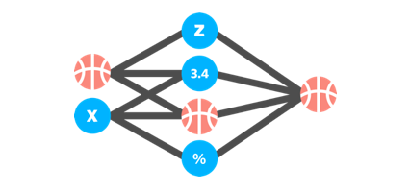

Can March Madness be Tamed with Math?
An exploration of constructing a probabilistic NCAA tournament bracket.
Baltimore-python
4/15/2015
Daniel O'Neill

Slide 2
Overview
Background on Competition
Benchmarks and Early Models
Refining the Models
Tracking the Competition
Results
Take-aways/Future Work/Recommendations
Questions

Slide 3
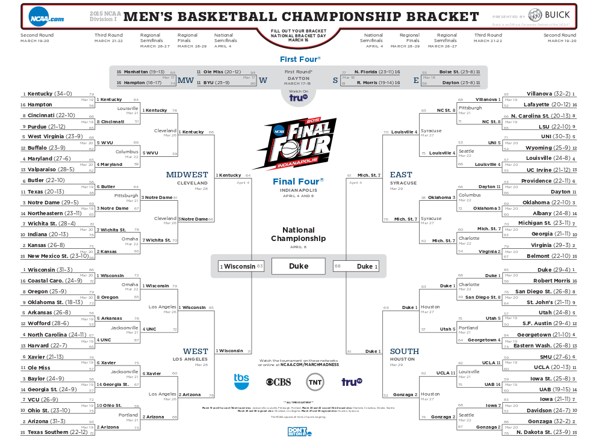
NCAA College Tournament

Slide 4


Machine Learning Mania 2015
www.kaggle.com
Founded in 2010
Over 200,000 kagglers
Devoted to a community of data scientists and learners solving data science problems
Competition and Learning

Slide 5

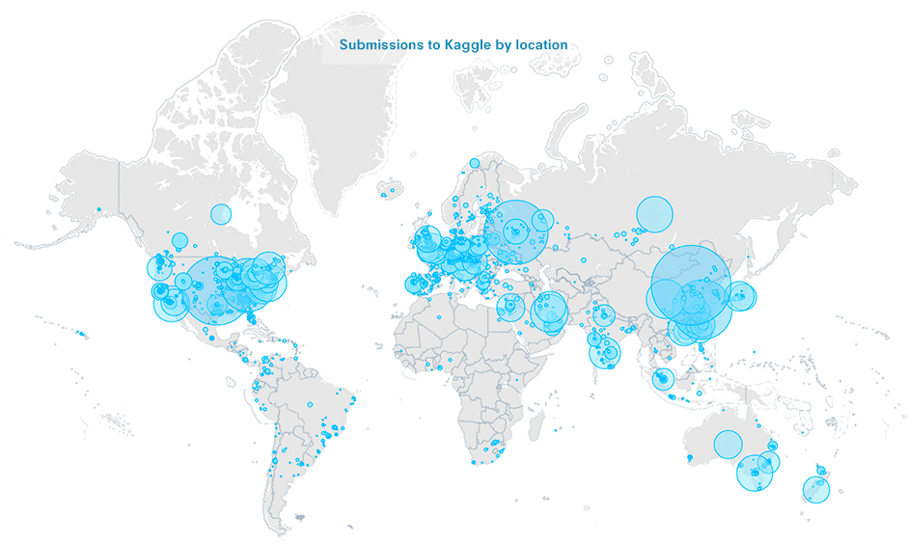
Bluefool:
Kaggle Master that had never seen a basketball game

Slide 6
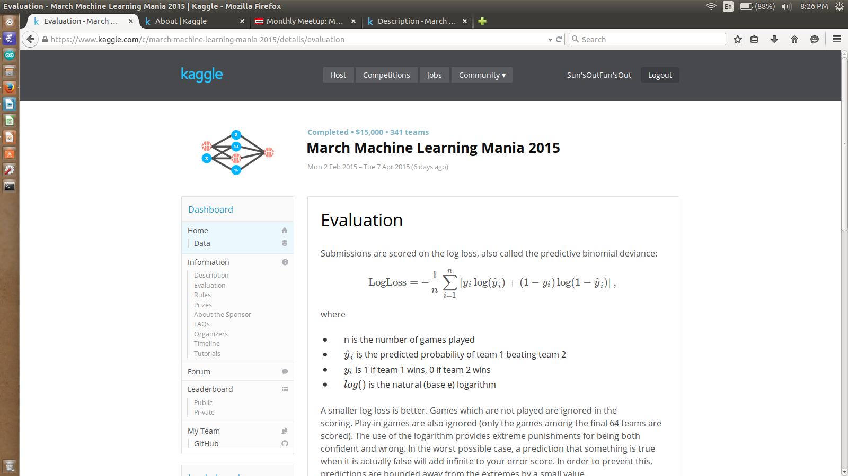
Rules of the Game
Provide Probabilities of Team A beating Team B for every possible combination (68*67/2=2278)
Scored on Games that Actually Happen (63)
All games weighted equally
Lowest LogLoss wins!
Correctly predict a game with 80% :0.22
Incorrectly predict a game with 80%:1.61

Slide 7
Data Provided
Stage 1 (Feb 2-Selection Sunday):
  Team Name File (Mapped team name to number)
  Regular Season / Tourney results (1985-2014)
  Regular Season / Tourney detailed results (2003-2014)
  Tourney Seeds
  Tourney Slot
  Evaluated on 2010-2014 tournaments
Stage 2 (Submissions due Day before Tourney):
  2015 Versions of data
  Follow leader board live
Additional Data: Massey Ordinals, Vegas Spreads, www.kenpom.com

Slide 8
My Philosophy on the Competition
There is an element of luck
  Sample size is very small for each prediction (1 game) True probabilities are never evaluated
  Probability of winning better than ESPN tournament
Submission does not have to be great
  Has to be reasonable
  Want it to be slightly different than a standard approach to separate from other competitors
Wanted to learn something

Slide 9
Overview
Background on Competition
Model Building
Tracking the Competition
Results
Take-aways/Future Work/Recommendations
Questions

Slide 10
Pandas
Python Data Analysis Library
Pandas is convenient for both live exploratory analysis and for incorporating into scripts
Uses DataFrame as primary object
Comparable to R
Allows for quick selection and sub-selection of data
Column names add to readability
Easy to aggregate
reg_season=pd.read_csv('regular_season_compact_results.csv')
train=reg_season[(reg_season.season>2000)&(reg_season.season<2010)]
train['win_pct']=1.*train['wins']/(1.*train['wins']+1.*train['losses'])
combined=pd.merge(results,seeds,how='inner',left_on=['wteam','season'],right_on=['team','season'])
Describe()
Head(), tail()
Sorting

Slide 11
Initial Benchmarks
Data was loaded into a Pandas dataframe
Submission file was created using Python itertools to find every combination of two teams
Lower number team placed first and then the probability of Team A beating Team B would be calculated
Checked with a 0.5 submission for all games
Moved to a linear model based on seeds

Slide 12
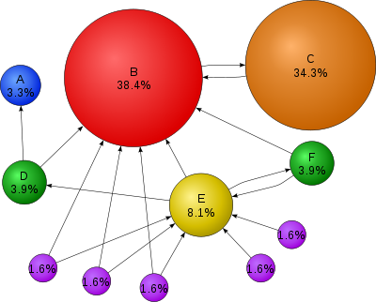
PageRank
Weights items based on their relative importance
Originally used in links for weighting webpages and the probability of a user moving to that page
Incorporates a level of randomness to ensure that the model does not spiral away from convergence

Slide 13

M^{k}z converges to the vector v*

Slide 14
Applying it to Basketball
All teams are a node in the graph
Each game is an edge
The losing team points to the winning team
  Later iterations of my model used score differential to weight the edges
  The score differential was adjusted to reflect home or away teams
  Took the log of the difference to adjust for some scaling problems

Slide 15
Adjusting the Randomness
Weight of the matrix that all teams have equal importance was given more probability in increments until a LogLoss on the test data was achieved
Ended up close to only using roughly 10% of the weighted matrix. This demonstrated that all teams are fairly equal
Rated Miami high because it beat Duke by a large differential. Did not make tournament.

Slide 16
95.00% | 5.00%
Duke | Duke
Kentucky | Notre Dame
Wisconsin | NC State
Virginia | Virginia
Gonzaga | North Carolina
North Carolina | Kentucky
Villanova | Miami FL
Arizona | Georgetown
Kansas | Villanova
VA Commonwealth | Kansas
Ohio St | Wisconsin
Baylor | Butler
Wichita St | Oklahoma
Notre Dame | Maryland
Northern Iowa | Providence
BYU | BYU
Arkansas | Baylor
Maryland | Syracuse
Cincinnati | Iowa St
Utah | West Virginia

Slide 17

SciKit Learn
Machine Learning Library built on numpy scipy and matplotlib
Extensive Machine Learning library for Python
Tools for Data Splitting
  cross_validation train_test_split, Kfold, StratifiedKfold
Data Preprocessing
  PCA, Data Scaling, BoxCox
Classification-Nearest neighbors, randomforest,GBM
Regression-Linear, Logistic, Ridge Lasso
Model Selection: GridSearch, RandomGridSearch
Well documented
All models follow similar structure of fit and predict
  Ensembling advantages

Slide 18
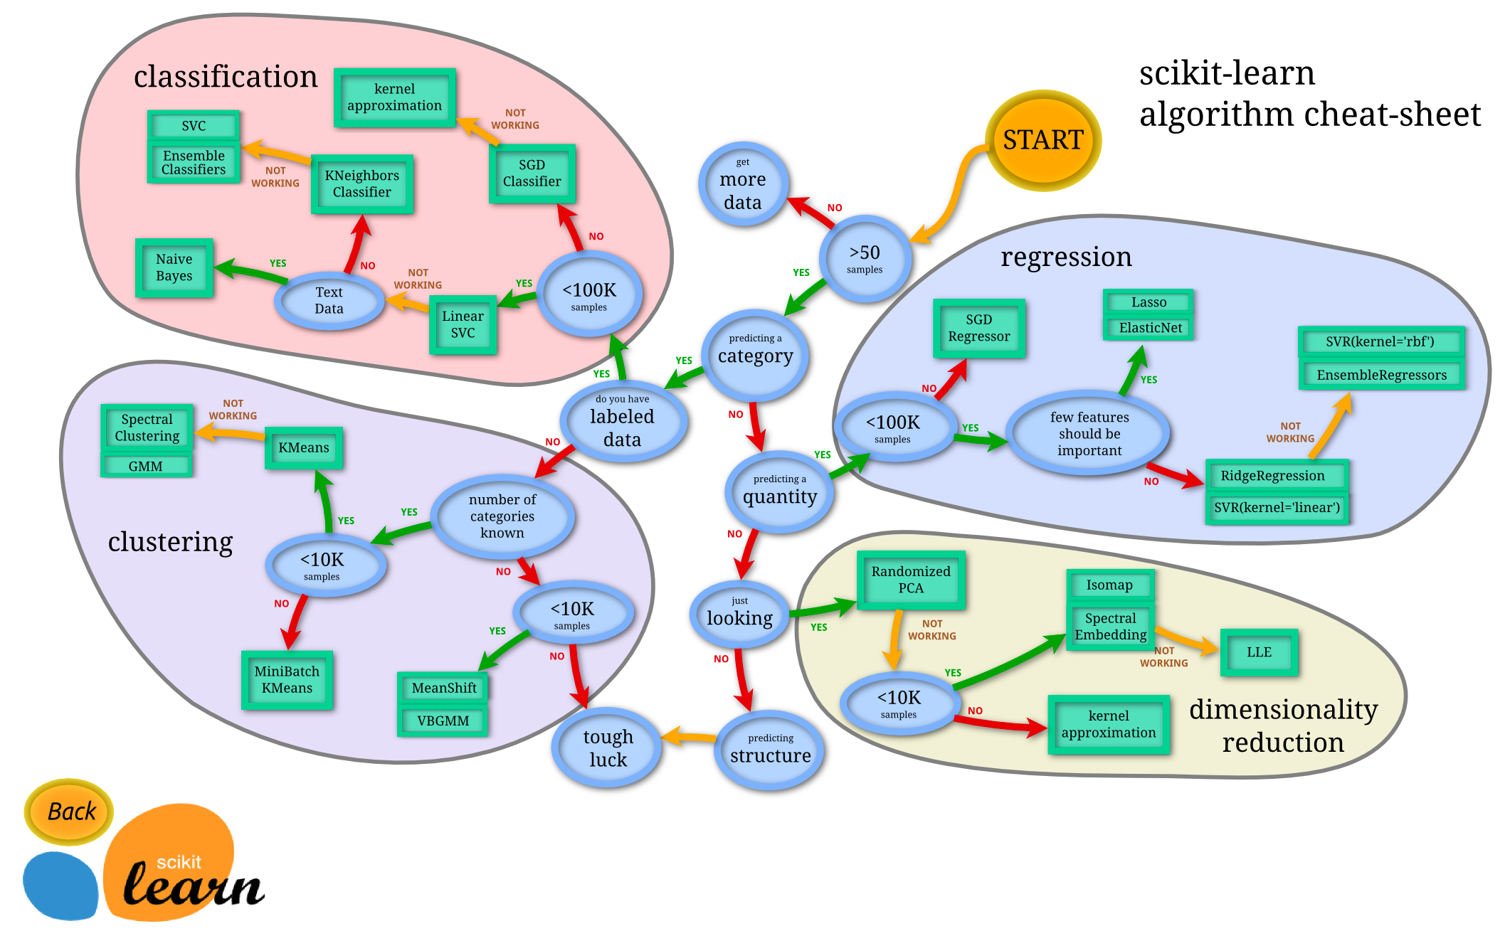
http://peekaboo-vision.blogspot.com/2013/01/machine-learning-cheat-sheet-for-scikit.html

Slide 19
Constructing Models
All data provided was given in terms of the winning team
Binary Classification
All data was doubled and inversed
  Seed difference was multiplied by -1
  All team attributes were flipped

Slide 20
Primarily Used Linear and Logistic Regression
Created Several Models Based on a Linear or Logistic Framework
Averaged them to reduce extremes
No regularization was used throughout

Slide 21
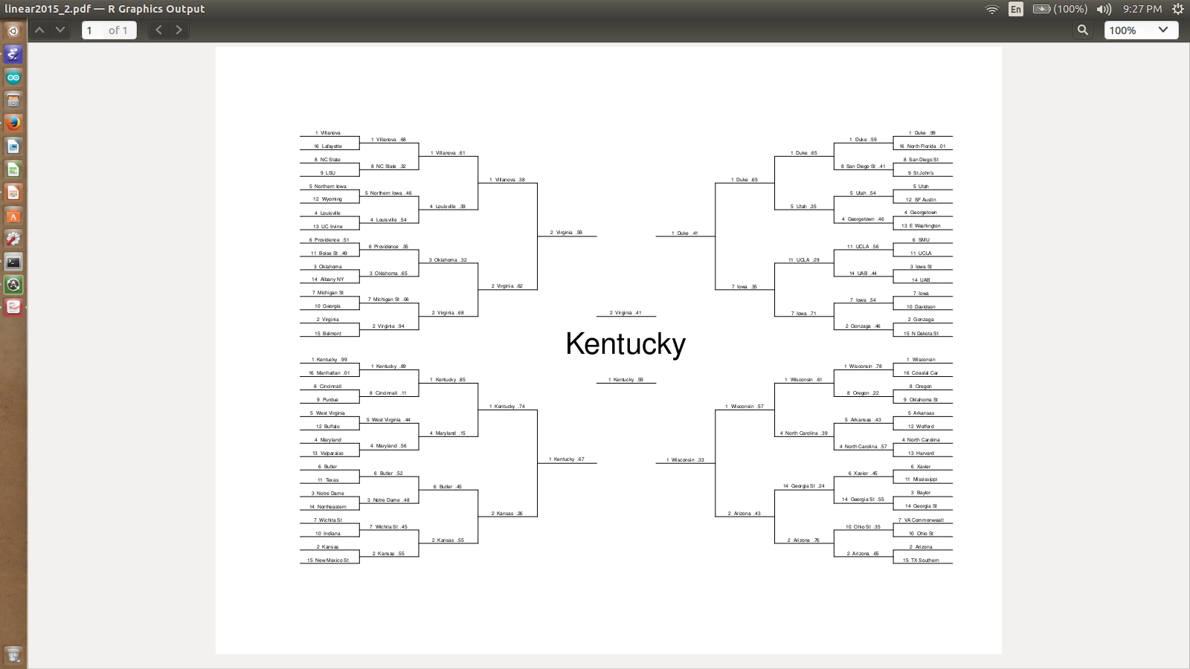

Slide 22
Overview
Background on Competition
Benchmarks and Early Models
Model Building
Tracking the Competition
Results
Take-aways/Future Work/Recommendations
Questions

Slide 23
More Madness!
NetProphet
  http://netprophetblog.blogspot.com/
Released his submission with random noise incorporated
BlueFool and others incorporated his model
One contestant copied his submission exactly and then gave Kentucky a 100% chance of victory in all games

Slide 24
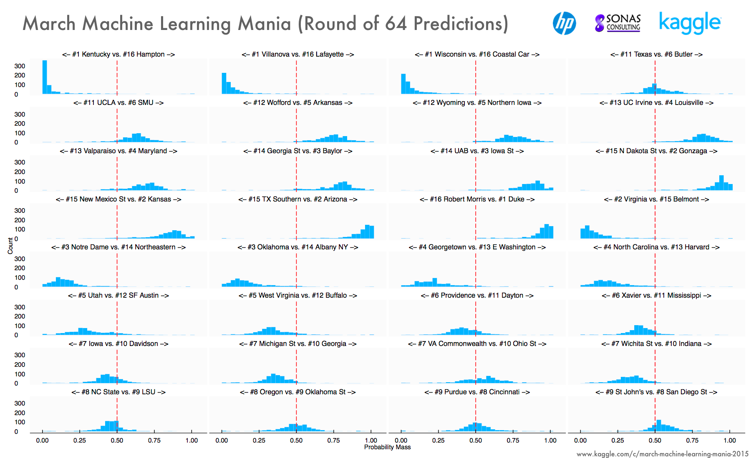

Slide 25
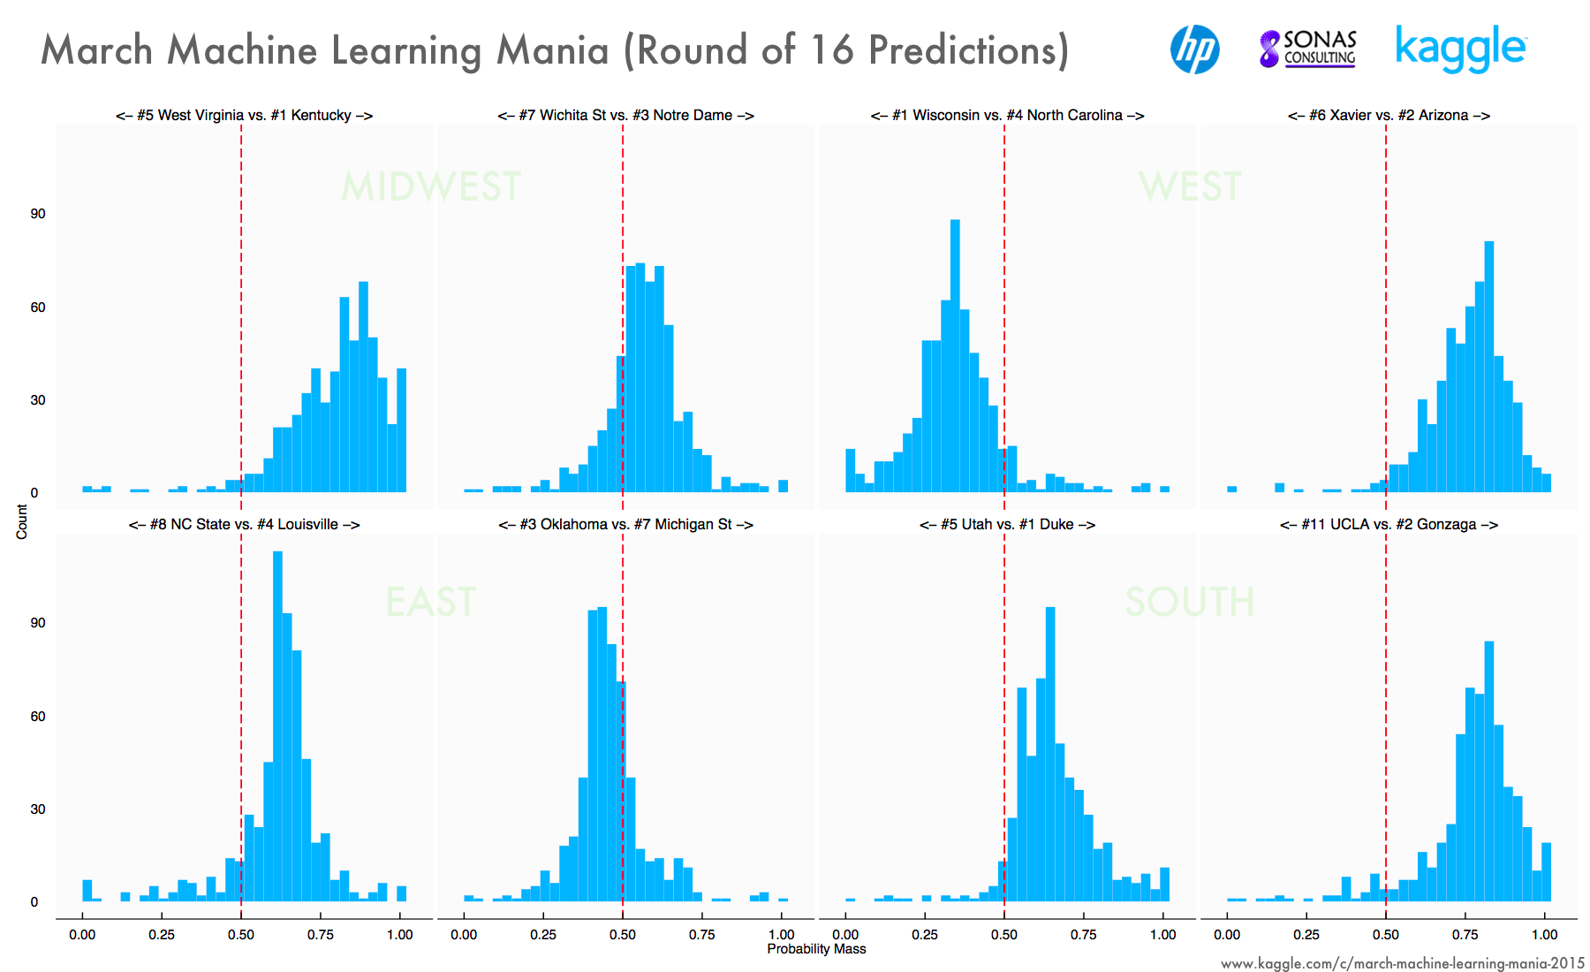

Slide 26
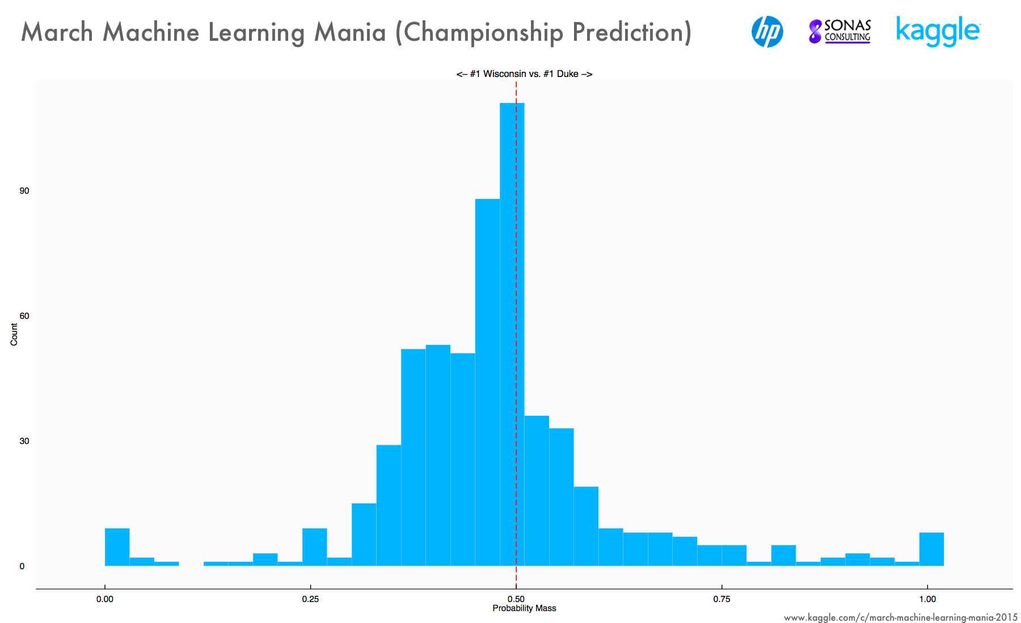

Slide 27
Overview
Background on Competition
Benchmarks and Early Models
Model Building
Tracking the Competition
Results
Take-aways/Future Work/Recommendations
Questions

Slide 28
Results
After Day 2 I was 18th out of 341. Feeling good
At the end I was 216th. Glad I don't bet
The winner had some odd predictions
  100% chance that #14 Georgia St would beat #3 GA
BlueFool only trained on tournament data and was able to come in 8th

Slide 29
Overview
Background on Competition
Benchmarks and Early Models
Model Building
Tracking the Competition
Results
Take-aways/Future Work/Recommendations
Questions

Slide 30
Take Aways
There is a level of gamesmanship with such a small sample size
Favorites do win but all teams are playing at a high level
Last year's winners ran simulations of how many times there model would win and found almost the entire board had a shot

Slide 31
Future Models
Incorporate Coach data
Perform more feature analysis and possible feature engineering
Weight the later part of the season
Focus more on blending models
Incorporate more ranking systems

Slide 32
Favorite Resources on Data Science
Applied Predictive Modeling- Max Kuhn, Kjell Johnson
The LION Way: Learning plus Intelligent Optimization- Mauro Brunato, Roberto Battiti
Podcasts: Talking Machines, O'Reilly Data Show
Coursera
edX

Slide 33
Questions?

